Slide 1
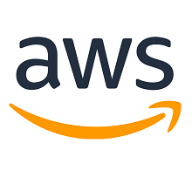
AWS- Amazon Web Services

Slide 2
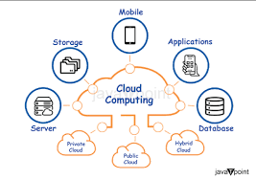
AWS:
It is a cloud service platform that provides on-demand computational services, databases, storage space and more.
AWS allows its user to select products from its vast variety of services and use it on-demand without any upfront payment for most of the services.

Slide 3
AWS installation Steps:
Sign Up for AWS:
Go to the AWS website.
Click on "Create an AWS Account" or "Sign Up."
Enter your email address, password, and AWS account name.
Verify Your Email:
AWS will send a verification email to the address you provided. Follow the instructions in the email to verify your account.
Provide Billing Information:
Enter your credit card or other payment information. AWS provides a free tier for many services, but you will need to provide payment details to activate your account.
Choose a Support Plan:
Select a support plan. AWS offers various levels of support, including a free basic plan.
Complete the Sign-Up Process:
Review the terms and conditions and complete the registration. You may need to verify your phone number and complete other security checks.

Slide 4
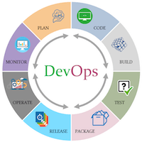
Devops:
The DevOps is the combination of two words, one is Development and other is Operations. It is a culture to promote the development and operation process collectively.
The DevOps tutorial will help you to learn DevOps basics and provide depth knowledge of various DevOps tools such as Git, Ansible, Docker, Puppet, Jenkins, Chef, Nagios, and Kubernetes.

Slide 5
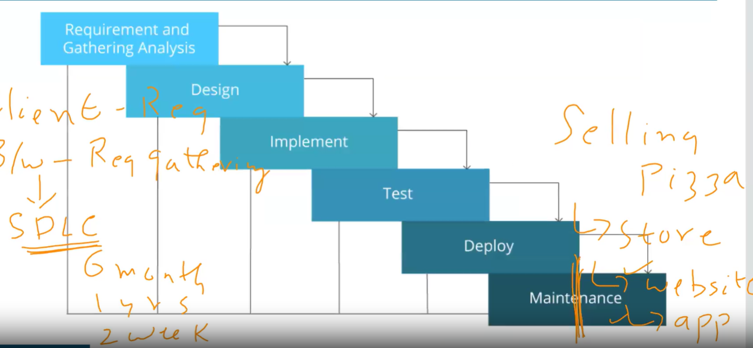
Waterfall Model:

Slide 6
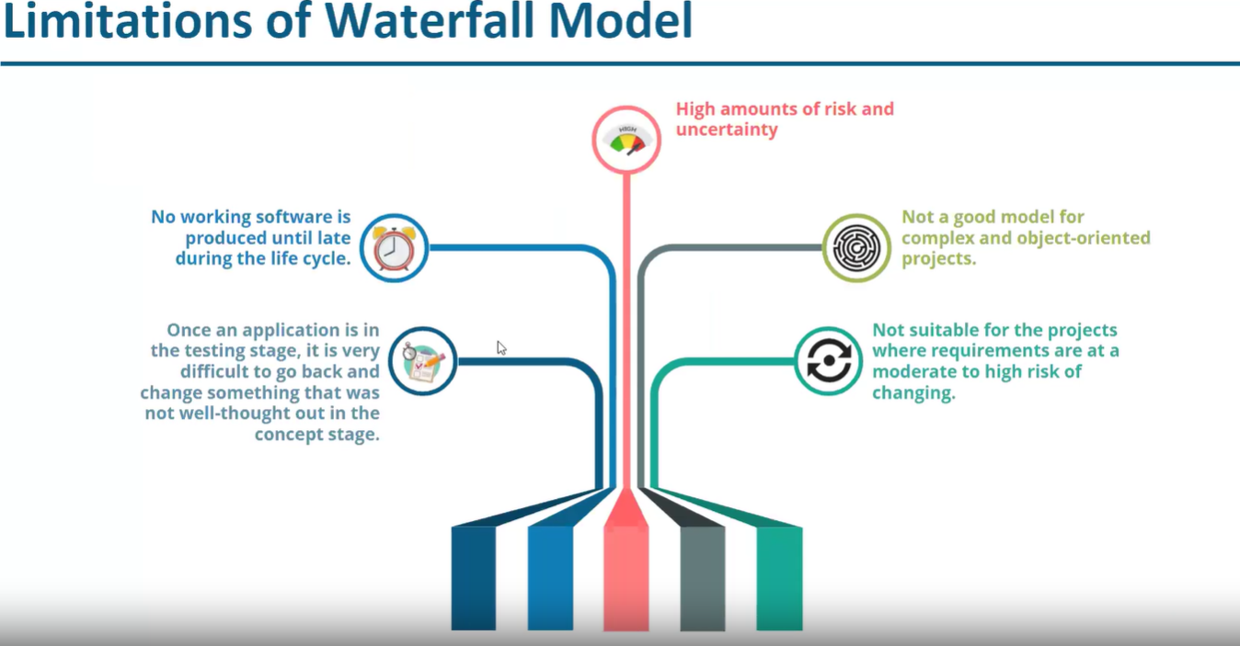

Slide 7
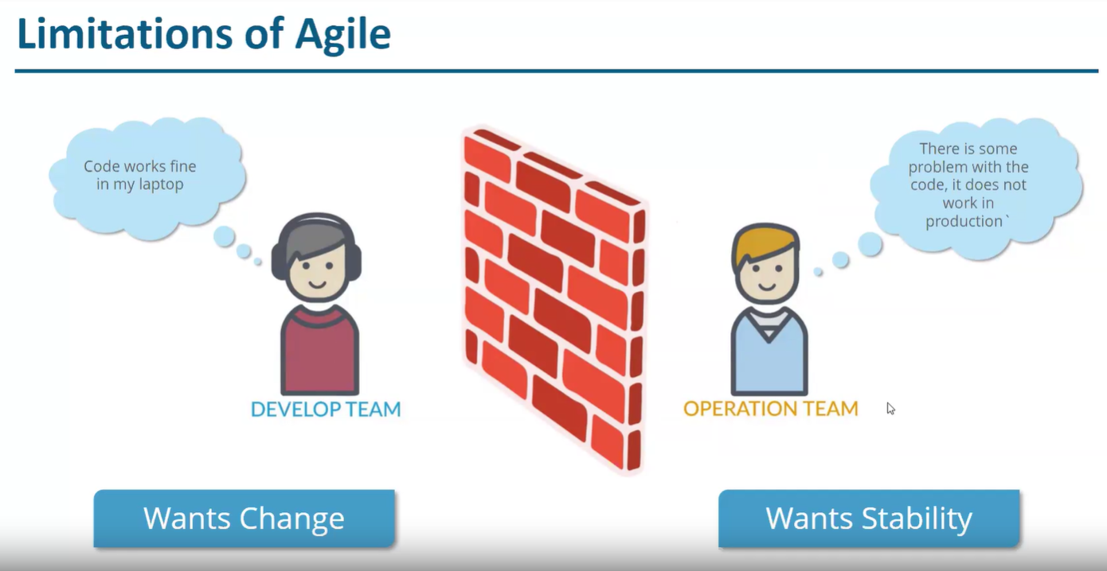

Slide 8
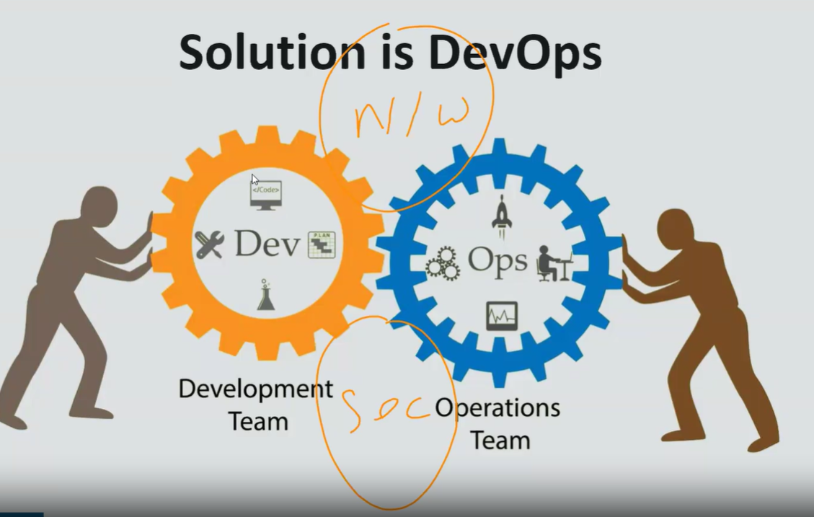

Slide 9
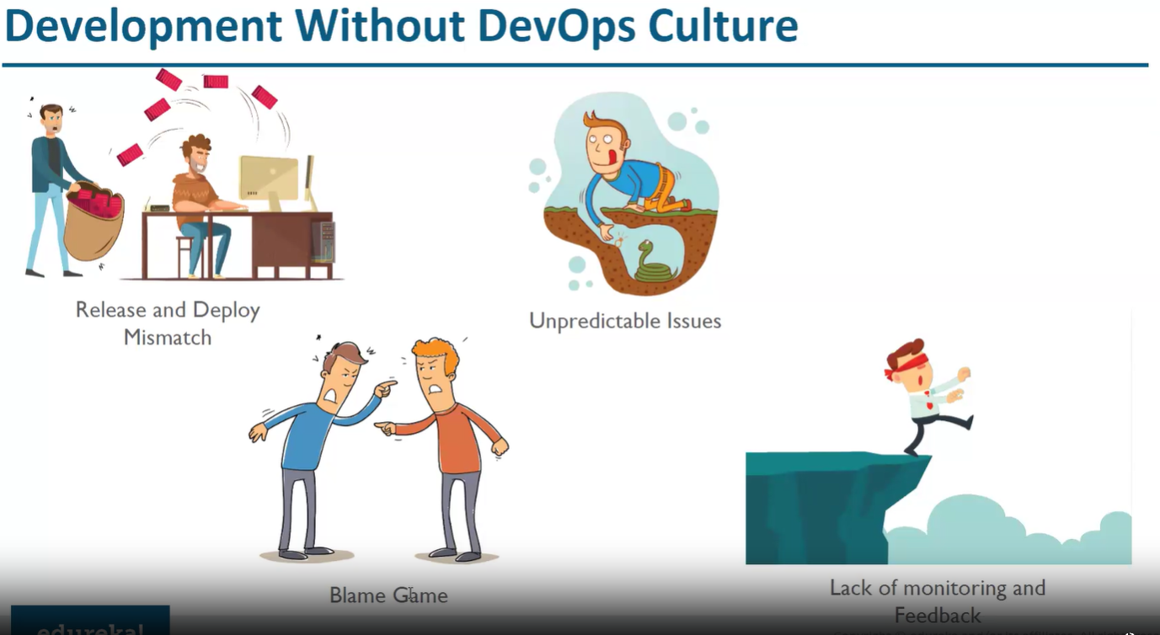

Slide 10
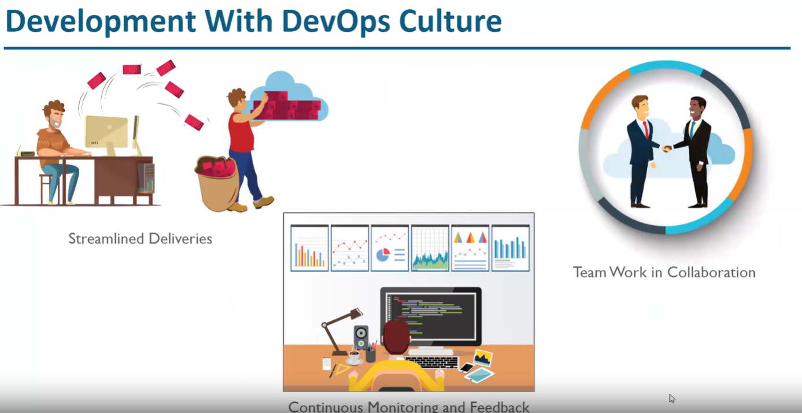

Slide 11
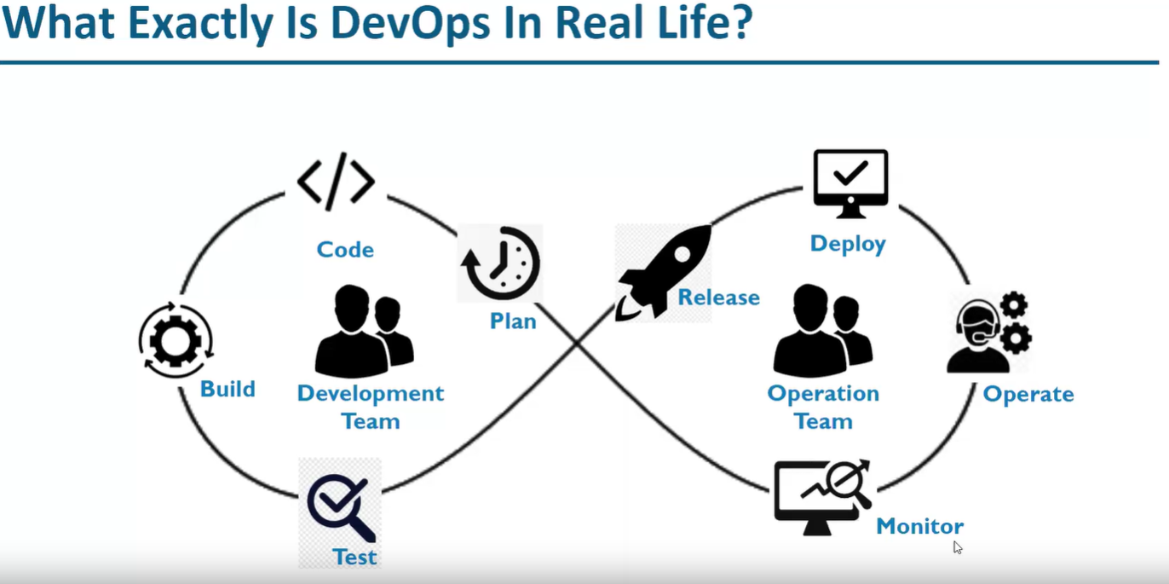

Slide 12
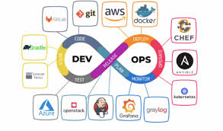
Tools Used:
Terraform
Git
Jenkins
Maven
Docker / Kubernetes

Slide 13
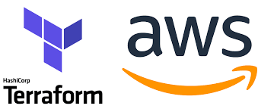
Terraform :
Terraform can be defined as a tool for versioning, changing, and building infrastructure efficiently and safely. It can manage popular and existing service providers and custom in-house solutions also.

Slide 14
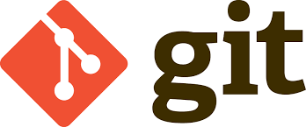
GIT:
Git is a version-Control System
Git is a free-open source distributed version control system designed to handle everything from small to very large projects with speed and efficiency.

Slide 15
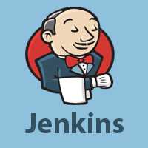
JENKINS
Jenkins is an open source automation tool written in Java programming language that allows continuous integration.
Jenkins builds and tests our software projects, which continuously making it easier for developers to integrate changes to the project, and making it easier for users to obtain a fresh build.

Slide 16
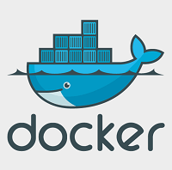
Docker
Docker is a centralized platform for packaging, deploying, and running applications. Before Docker, many users face the problem that a particular code is running in the developer's system but not in the user's system. So, the main reason to develop docker is to help developers to develop applications easily, ship them into containers, and can be deployed anywhere.

Slide 17
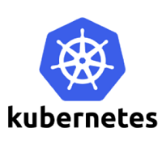
Kubernetes
Kubernetes is also known as 'k8s'. This word comes from the Greek language, which means a pilot or helmsman. Kubernetes is an extensible, portable, and open-source platform designed by Google in 2014. It is mainly used to automate the deployment, scaling, and operations of the container-based applications across the cluster of nodes. It is also designed for managing the services of containerized apps using different methods which provide the scalability, predictability, and high availability.

